Slide 1
Lecture 1

Slide 2
Plan of presentation
Introduction to python
Standard python commands
Comments in python
Variables
String properties
Introduction to GitHub
GitHub terminology
Standard git commands

Slide 3
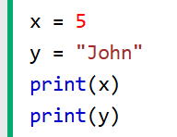
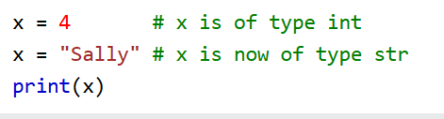
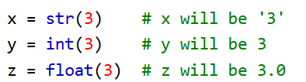
Introduction to python
Python is a high abstraction level programming language
Python syntax is indentation based
Python has no variable declaration

Slide 4

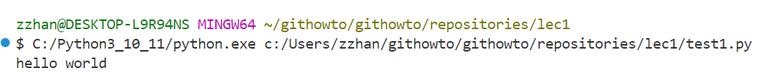
Standard python commands
print(arg) – a standard python function for outputting in console
input() – standard python function for inputting values

Slide 5

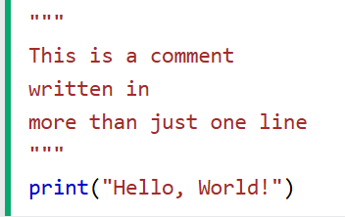
Comments in python
Python supports two ways of making comments:
a single line style, with “#” symbol
a multiple line style, with triple enclosed double quote
Second option is preferrable when documenting a function or a class

Slide 6
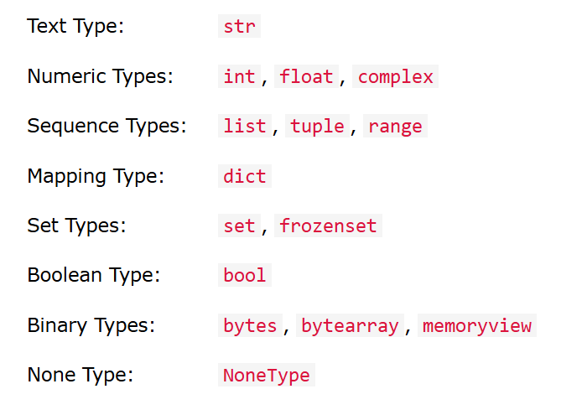
Python data types
In programming, data type is an important concept.
Variables can store data of different types, and different types can do different things.
Python has the following data types built-in by default, in these categories:

Slide 7
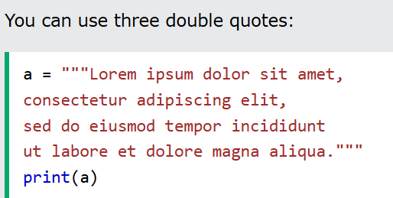
Multiline strings
You can assign a multiline string to a variable by using three quotes:

Slide 8
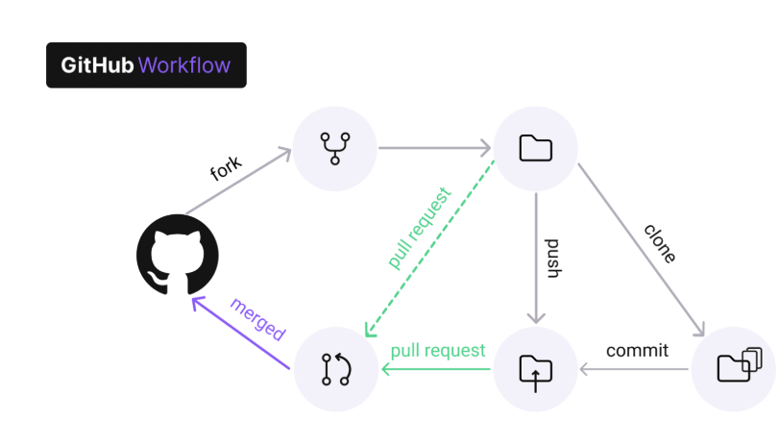
Introduction to GitHub
Github is a version control system

Slide 9
GitHub terminology
Repository – a storing place for a project and its history. Usually is stored in a hidden subdirectory called .git
Commit – a snippet of a change made to your project. Chain of commits constitutes history of project changes

Slide 10
GitHub terminology
Fork – parallel version of the repository, allows the user to work on changes to the project without compromising the main version of the project

Slide 11
Standard git commands
git init – is used to create and initialize .git file in a specific folder
git add – is used to index the changes to files in the folder with .git file
git commit – commits changes that were added

Slide 12
Standard git commands
git log – used to look up the history of changes
git checkout <hash> -- used to check the old state of the repository
cat – used to see the state of the file
git switch main – used to switch back to the current state of the repository

